Slide 1
Chapter – 2
Your First commit

Slide 2
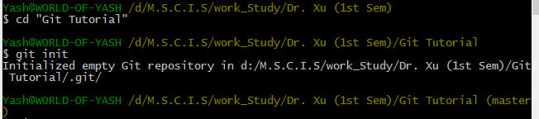
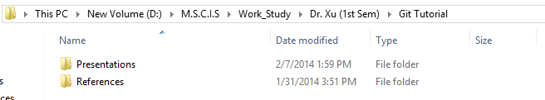
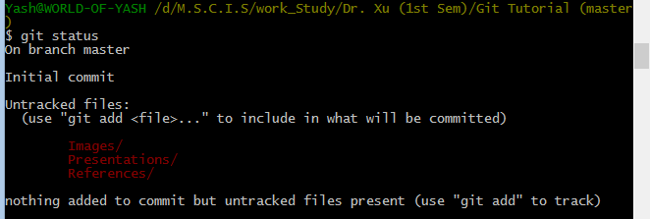
Create and initiate your repository.
Go to the project’s folder and add some file to track.
Check GIT STATUS.
1.
2.
3.

Slide 3
Using ADD and REMOVE function

Slide 4
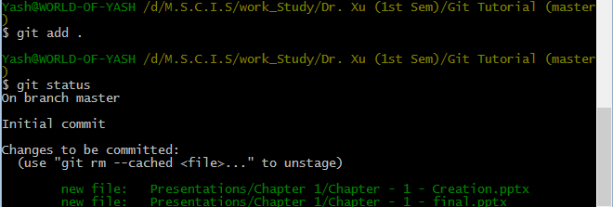
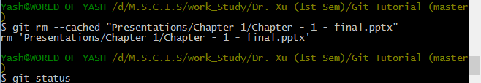

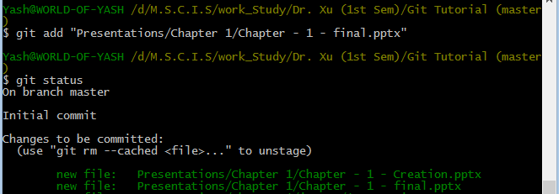
Use GIT ADD for all.
Use GIT RM to remove a file.
Use GIT ADD for specific file.
1.
2.
3.

Slide 5
The COMMIT
“Add” command was used to track the files, But to actually push your files to the repository you need to “commit” the changes(files) you added

Slide 6
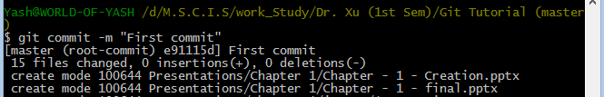
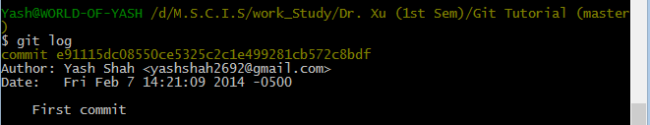
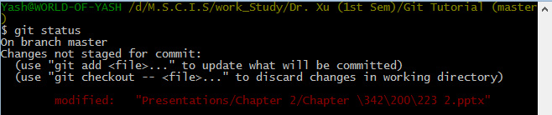

Use “Commit” with a message (-m) , message is used so that you can check back later, why you committed at this stage.
Check log to see your committed changes.
Modify a file in your repository.
See the status, and commit the changes.
Repeat the above steps : First ADD and then Commit, Remember you cannot commit until you ADD the change.
1.
2.
3.
4.

Slide 7
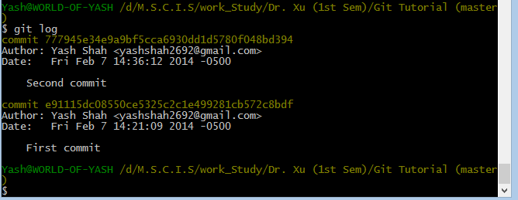
See the GIT LOG

